Slide 1


STARTING A COMMUNITY GARDEN
WHERE YOU LIVE
CREATED BY TARRANT COUNTY
MASTER GARDENER’S

Slide 2
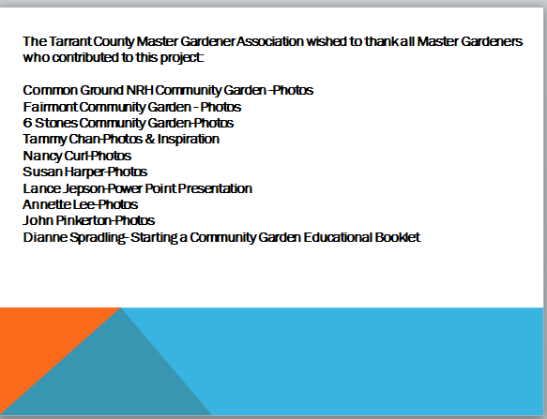

Slide 3
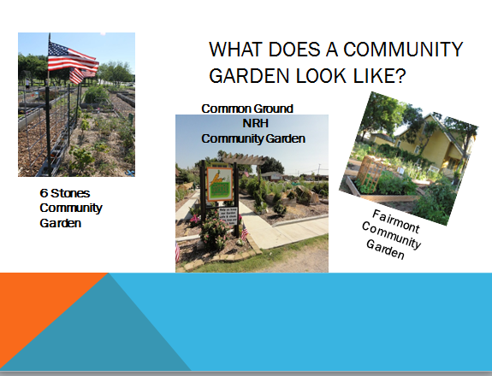

Slide 4
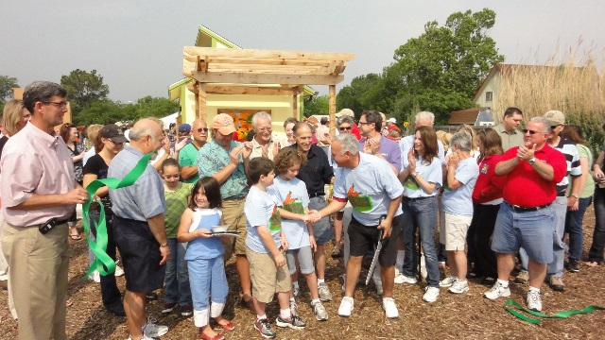
FIRST GET PEOPLE INVOLVED
Notes:
Is there a need or desire for a community garden
Have you been approached by any organization
What kind of community garden
Public Garden
Food bank garden
Private community or church garden
Your garden rules need to reflect and be very clear as to the type of garden you are

Slide 5
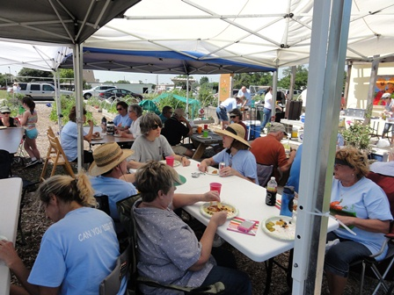
A. BUILD A VOLUNTEER BASE
THIS IS A MUST
Notes:
YOU NEED A DEDICATED GROUP OF PEOPLE TO SEE THIS PROJECT THROUGH FOR YEARS TO COME

Slide 6
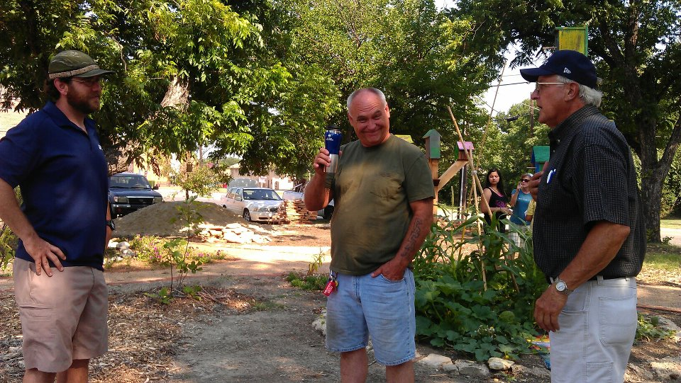
FORM A GARDEN CLUB OR COUNCIL
Notes:
Elect a coordinator, secretary, treasurer and garden stewards to share in the building responsibilities and sustainability of your garden. Documenting the gardens creation from the very beginning will allow you to communicate its growth to others. Minutes to all meetings need to be documented and shared. Monthly meetings are encouraged to keep everyone on the same page. This is the beginning of your gardens infrastructure.

Slide 7
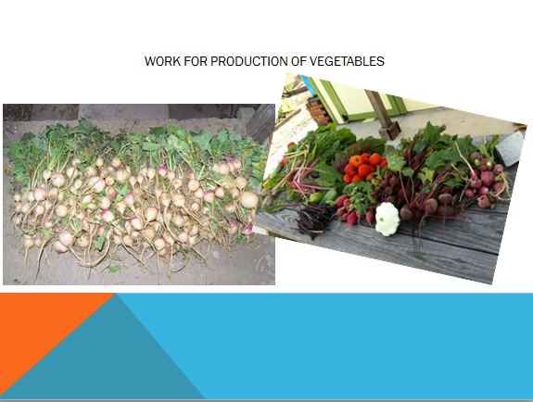

Slide 8
You want to start a garden
Not just any garden. You want to start the kind of garden that does more than just grow food.
You want to transform lives. Change neighborhoods.
Many have started community gardens, and many have ended in weeds and frustration.
SO WHAT DO YOU NEED.

Slide 9

STEP 1-RECRUIT NEIGHBORS
SELECT A CORE GROUP OF COMMITTED PEOPLE
Volunteers with a strong desire and need for a garden
Volunteers who will work in the garden

Slide 10
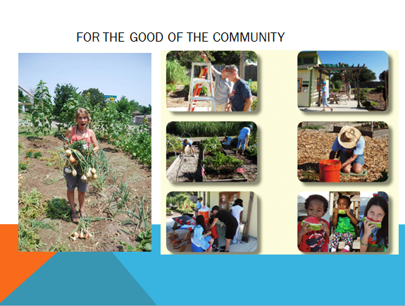

Slide 11
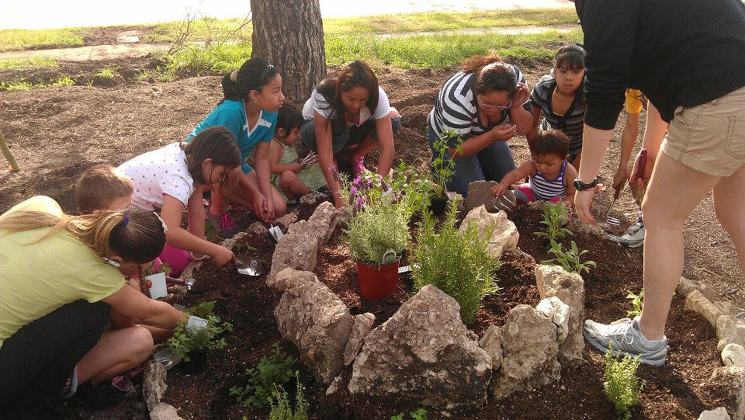
Visit local community gardens for ideas you might want to see in your community garden.
  http://communitygardensdfw.org/local-gardens
  http://www.communitygarden.org/

Slide 12
STEP 2-
DRAFT A MISSION STATEMENT
A clear purpose of the garden.
The type of role will the garden play - food production, community building, environmental restoration, beautification, recreation?
Develop a decision tree to determine how the garden will be managed (democratic vote, consensus, board of directors, etc.)?
How will the garden be funded
Notes:
YOUR GARDEN LOGO AND ADDRESS HERE
(Your gardens’ name here) By-Laws
Article I – Name and Mission Statement
Section 1.00, Name –The name of this organization shall be (Your gardens’ name here) (herein after “(Your gardens’ name here)” or the “Corporation”).
Section 2.00, Mission Statement
(Your gardens’ name here) is a voluntary organization organized to help build a sense of community and pride through collaborative gardening efforts that focus on the principles of organic gardening and to act as a center for educating and encouraging others to participate in gardening communities wherever they live and provide for others in need.
Article II – Membership
Section 1.00, Definition
A member is someone who has been granted rights to a particular plot(s) and who agrees to and abides by the rules and requirements of the (Your gardens’ name here) defined herein the By-Laws.
Section 2.00, Prospective Members
Membership is available on a first come first serve basis to the first (number of plots here) interested parties and is open to surrounding area residents regardless of race, gender, national origin, color, religion, age, or sexual orientation. If all garden plots are occupied, prospective members’ names are placed on a waiting list. A prospective member of the (Your gardens’ name here) who has been offered a plot assignment must sign a gardening agreement and submit the associated membership dues to become a member.
Section 3.00, Current Members
A current member in good standing may retain the assigned plot and remain a member of the (Your gardens’ name here) the following year by signing the agreement and paying the required membership dues at time of plot registration.

Slide 13
Step 3—Develop a Mission Statement continued:
It should include:
Who can participate
What is expected of members
How much time per week is expected from each member
And what the garden will grow. (Vegs, flowers, etc.)
Notes:
Section 4.00, Membership Sign up and Dues
Memberships shall run from January 1st through December 31st of each year, but a member may join at any time during the year. Membership dues are $40.00 per year, are non-refundable, and are to be paid at time of registration.
Section 5.00, Termination of Membership
A thirty (30) day grace period is granted on membership renewal. If membership dues and forms are not received by the end of the grace period, then the member shall lose their membership and all (Your gardens’ name here) privileges. Membership and plot privileges may be revoked by the (Your gardens’ name here) Garden Council for violation(s) of the rules established by the (Your gardens’ name here) Garden Council. If a member fails to fulfill their responsibilities or breaks membership rules, the (Your gardens’ name here) Garden Council will notify the member in writing with details outlining the infraction(s) and what actions are required to rectify the situation. Members will be given 30 days to rectify the situation.
If the member fails to rectify the situation, the (Your gardens’ name here) Garden Council will meet and discuss the situation and determine whether the member will be given further time to resolve the issue or whether their membership is to be terminated. A vote of 75% of the council members is required to terminate membership. If membership is terminated, the member’s garden plot will be given to the next person on the waiting list and all membership dues paid in that year will be forfeit.
Section 6.00, Membership Guidelines
Two (2) work days per month will be scheduled to perform general site cleanup, weeding and other maintenance activities. Each Member is requested to attend at least one (1) work days per month. Work days will be established by the (Your gardens’ name here) Garden Council and published on the bulletin board and other established communication methods. The (Your gardens’ name here) is an organic garden project. Only organic fertilizers, pesticides and fungicides may be used in the garden. A list will be provided of Organic Pesticides, Fertilizers and Disease Control options.
Others may be approved by the (Your gardens’ name here) Garden

Slide 14
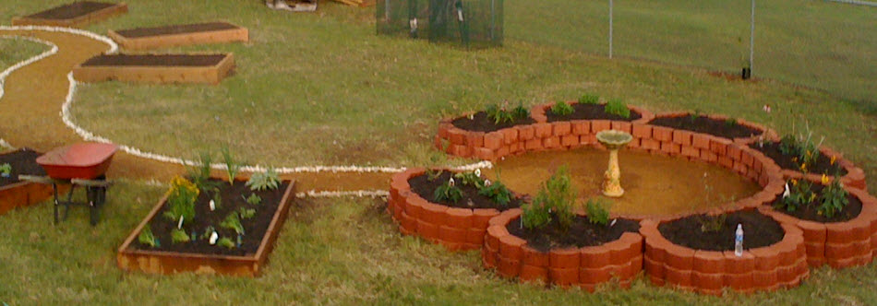
Design options

Slide 15
STEP 4--Look at potential sites.
When looking for a site consider the following factors:
Exposure to light. The number of hours that the sun is available , remember many vegetables require six hours of light to produce fruit.
Availability and cost of water to the beds.
And the condition of the soil. Is it rocky, clay, alkaline, grass
weedy etc.
Notes:
Who owns the land
Contact your county’s tax assessor’s office
Contact the Owner
Is the land available for lease and how much (most landowners will lease for $1.00 per year to community gardens, but not always) another budget line item.
Soil test the site (line item in your budget)
The soil may not be suitable due to contamination by chemical dumping
If it is suitable you need to know what nutrients need to be added (or not added) and what amount you need to add.

Slide 16
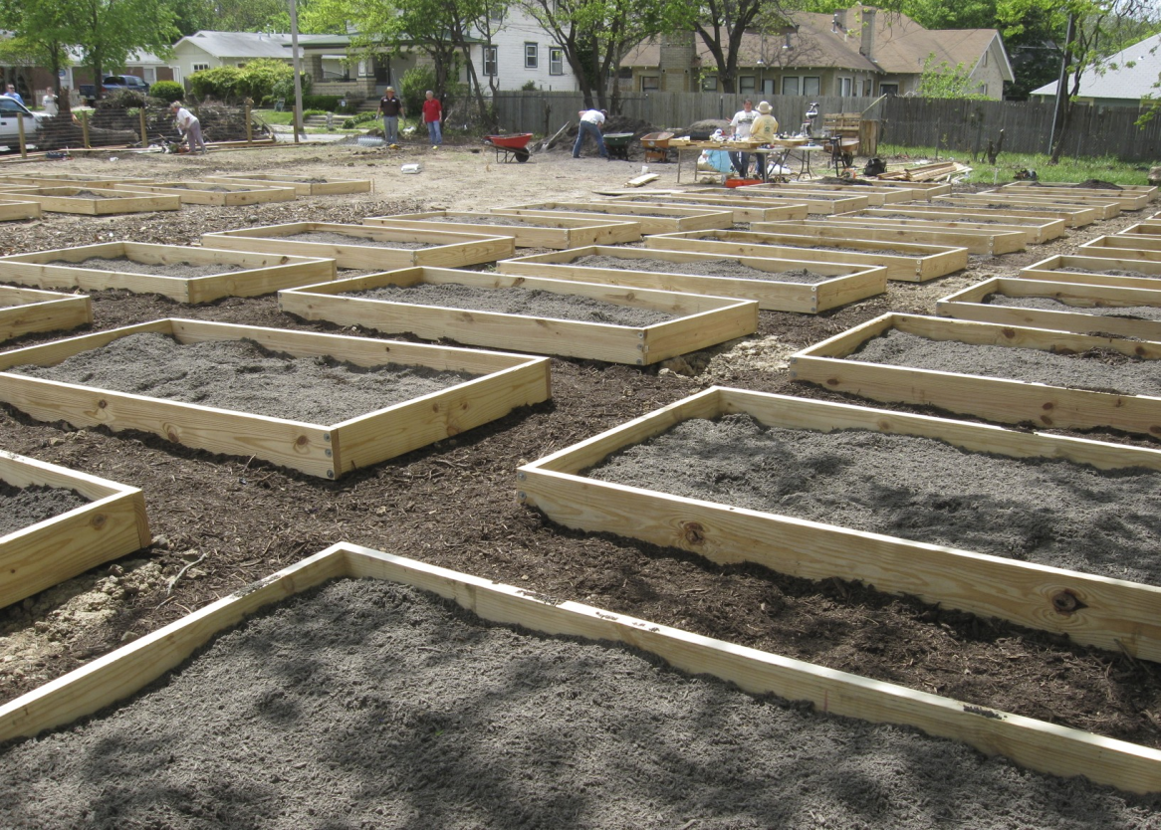
Find land for the garden
Key Elements
Light
Drainage
Parking
Water
Notes:
Is the land suitable for a garden
Enough light (a least 6 to 8 hours of sun per day)
Drainage
Accessibility
Parking
Does it have a water supply available or close by
Contact the water service provider in your area for existing water meter or lines to hook into.
Who will pay for the water and it’s connectivity to the garden $$ (This should be a line item in your budget)

Slide 17
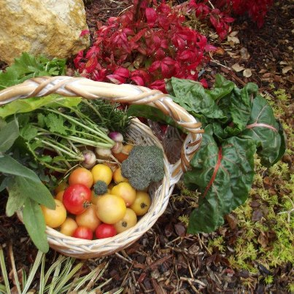
Land Issues
Who are the neighbors
Does it meet Zoning
City Permits
Site Plan
Lease Agreement
“hold harmless”
Liability Insurance
Notes:
What do the local neighbors think about a community garden (This could be a show stopper from the get go)
Some think a community garden will be noisy and an eye sore. If they are invited to be a part of it and you show how they and the neighborhood will benefit, you will have a good chance. Getting the surrounding community involved is key to harmony.
Does it meet city, church or owner zoning and/or other code requirements for a garden
Contact your cities Planning and Zoning Department
Try to get members of your city council involved. Backing from city council will greatly improve your gardens success.
What city permits are required to build the garden and where are they buried phone, water, electrical, gas lines. Permits could be another line item in your budget
CALL 811 BEFORE YOU DIG. http://www.call811.com/
You will need your site plan (to scale) already drawn up if you are going to the city for any permits
Include all buried cables and lines on you plan
Include right-of-ways and property easements. Contact your cities’ public works department for these.
Draw up a lease agreement. Who pays for the attorney to do this (another line item in your budget)
Landowners will most likely require a “hold harmless” waiver in the lease. The same waiver should be included in all the gardens forms and paperwork each gardener signs. *See example below.
Sign the lease if it meets your requirements

Slide 18

LIABILITY insurance
The land owner may require this.
How much and who will pay for it?
Notes:
It is becoming increasingly difficult to obtain leases from landowners without liability insurance. Garden insurance is a new thing for many insurance carriers and their underwriters are reluctant to cover community gardens. It helps if you know what you want before you start talking to agents. Two tips: you should probably be working with an agent from a firm which deals with many different carriers (so you can get the best policy for your needs) and you will probably have better success with someone local who has already done this type of policy or one that works with social service agencies in the area. Information from the American Community Garden Association web site.

Slide 19
STEP 5 -Secure a Sponsor
Visit local businesses that support agricultural or garden causes. Talk with
churches with garden areas, schools, might even have areas for gardens
A sponsor can contribute lumber, tools, seeds and other supplies
If you can not find a sponsor you will need to find other ways to raise funds, such as charging a membership fee.

Slide 20
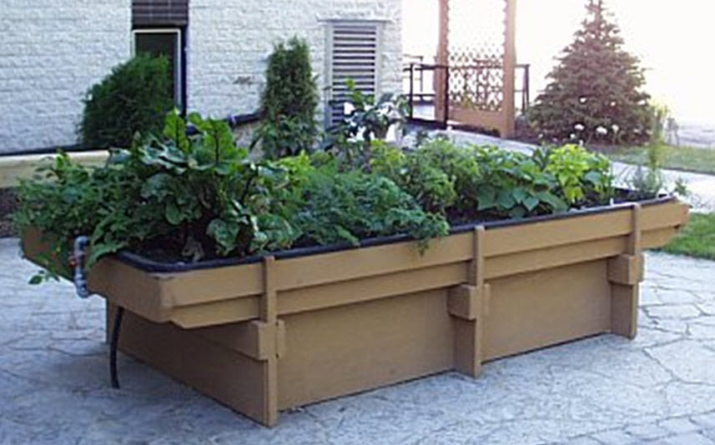
INFRASTRUCTURE
DEVELOP A SITE PLAN
a. Size of plots
b. Raised beds
c. ADA accessible
d. Fence
e. Tool Shed
f. Benches Tables
g. Shade.
h. Composting
i. Trash removal
j. Attend classes
Notes:
Develop a site plan, to scale, with all things laid out and identified, even your wish list items. How many plots and placement for maximum sun exposure
Size of plots, how many and distance between them
Raised plots should be no more than 4’ wide. This will allow easy reach from the sides to the center of the plot. The length can be whatever you like that fits best in your gardens layout plan. Children’s plots should be 4’ X4’. This allows them easy reach from all sides and is not too large to be easily managed by them. Too large is sometimes very daunting. The space between any of the plots would be 4’ also. Allowing easy access of carts or wheel barrows.
Raised blots and how high
Most standard raised plots are about 12” high. In our Texas heat the 12” depth helps plant material stay hydrated. If you have people with lower back issues, 24” to 30” will allow easier access without too much stooping.
Will it be ADA accessible – You will have to follow specific guidelines
http://www.dol.gov/dol/topic/disability/ada.htm
Do you need or want a fence (if the property is not in a highly visible location a fence is a great asset against vandalism) Another budget line item
Tool shed w/ commination locks that can be changed yearly)
Shed will fall under design permits by city
Benches, picnic tables where gardeners can relax
Shade
Sign with gardens name
Composting or orchard area
Trash removal, how or who does this.
Composting areas can become a problem if they are not managed correctly. They can create unsightly views and odors to surrounding neighbors. An unhappy neighbor can be your gardens down fall.

Slide 21
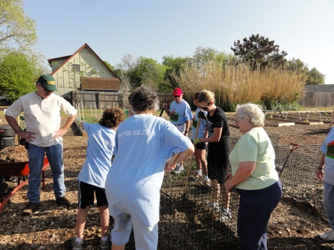
COMPOSTING CLASSES

Slide 22
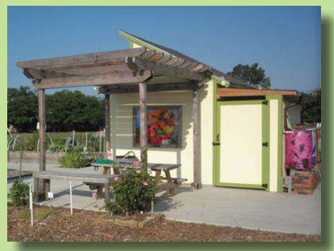
funding
Create a garden budget
a. List of Materials
b. Plot rental
c. Cost of water
Sources of funding
Big Box Stores
Energy Companies
Garden Raisers
In kind donations
Local High schools
Boy Scouts
Community Service programs
Notes:
Create your gardens budget.
Develop a materials list. Identify the cost of each line item and cost out the entire project. You may find you need to approach the building in phases to keep cost down until more money and /or materials become available.
How much will you charge for plot rental (Water will be your biggest ongoing budget line item, plan accordingly)
Check with the water provider for possible lower rates.
Where will you get money for building materials and help building your garden
Big box stores
Other local business
Energy companies
Garden fund raisers
In kind donations
Local high schools/colleges
Boy Scouts of America
Your cities teen court community service programs
Inmate community service programs
How much money is needed to sustain your garden on a yearly basis or longer (Always look ahead)
You will probably need as least $2.000.00 to $3,000.00 to start work on your garden.
Set up a garden bank account
You will need a central account to keep plot rental dues, fund raiser and donation monies, etc.
Have your gardens coordinator and treasurer set this up with a two signature requirement
Check your local banks for the best rates
Choose a bank close by and easily accessible
You will pay for your gardens on going needs from this account

Slide 23
communication
Have clear enforceable garden rules with strong leadership in a garden coordinator and council to enforce them.
This will help with any communication problems with other gardeners.
Create an adopt-a- plot form with gardener’s information, contact, address, phone, etc. *
Create an adopt-a-plot rules form and spell out what is expected of each gardener *
create policies , procedures and guideline rules for your garden.
Create your garden by-laws *
how will you communicate with gardeners who speak a different language?
Set up your own garden web site and a garden members g-mail account. Include, facebook, blog, and twitter, youtube or any other media to keep your gardeners aware of what is going on
Notes:
Connectivity is your gardens life blood
You’ll need a domain name for your web page. Places like Go Daddy http://www.godaddy.com/ are great places to start and involve very little cost.
Google Sites has free website help, but you will need to set up a Google account. The following url’s will help guide you.
http://support.google.com/accounts/bin/topic.py?hl=en&topic=2364542&parent=TopLevel&ctx=topic
http://www.google.com/sites/help/intl/en/overview.html
http://home2.fvcc.edu/~drausche/tutorials/google.pdf
Information &Educational Links: http://tarrantmg.org/ http://www.communitygarden.org/learn/tools.php https://agrilifebookstore.org/ http://www.ahs.org/ http://www.kidsgardening.org/ http://www.jmgkids.us/ http://vegipm.tamu.edu/ http://aggie-horticulture.tamu.edu/vegetable/files/2010/10/E-502_home_vegetable_guide.pdf
Fun links for videos, etc. This would include YouTube, Facebook & blog links: http://animoto.com/ http://www.facebook.com/about/pages
http://support.google.com/youtube/bin/static.py?hl=en&page=guide.cs&guide=1646810

Slide 24
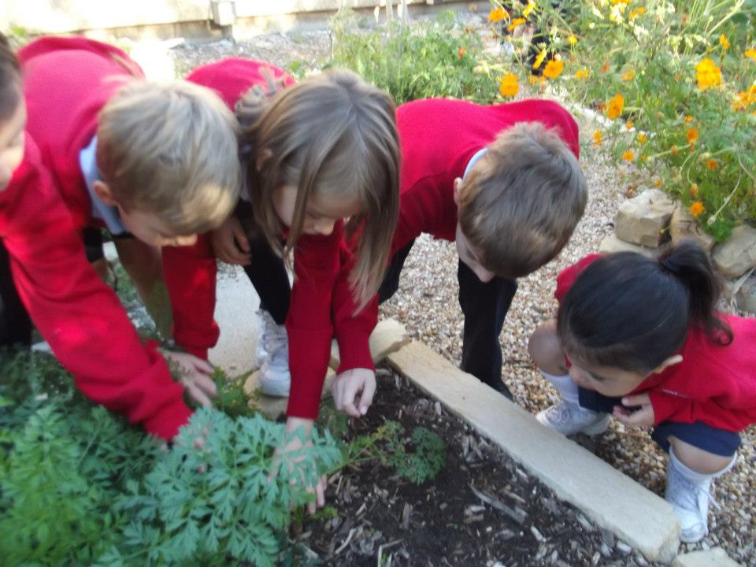
501 3c
What is it?
TAX FREE STATUS
Notes:
Do you want to be a non-profit corporation
If you are applying for grants you will need 501 (c) 3 status.
You can have a sponsor with 501 (c) 3 tax-exempt status or apply for one yourself. This can be a lot of work. http://www.501c3.org/

Slide 25
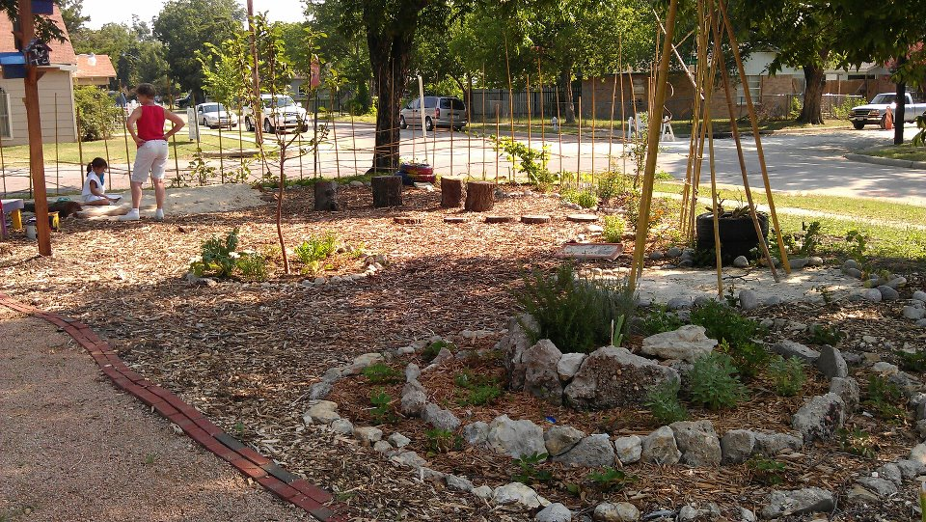
STEP 5-Green up your thumbs
Work in nearby gardens or with other established gardens
Take free or low cost workshops, take free or low cost workshops from the Tarrant County Extension Service.
Notes:
Get things growing while you continue your fund raising efforts and as materials become available? Remember Rome wasn’t built in a day. Gardeners need to get down and get their hands dirty while keeping their moral high.
Get the community involved in your build day
Clean the site
Identify garden parameters, install weed block, stake out plots, shed placement, compost or orchard location, etc.
Install the irrigation system to meet the needs of your gardens layout plan (current and future additions)
Plant something, even a fruit tree or your gardens perimeter plantings (like Texas native plants and flowers), anything to keep the enthusiasm of your gardeners high.
Plan a celebration with a bar-b-que or pot-luck lunch
Invite the local police to visit your garden. They can lend invaluable advice on security and they know the local neighborhood.
Acknowledge everyone who helped build the garden, from businesses, city, church, school and individuals.

Slide 26
Registration information
Returning Gardeners
The (Your gardens’ name here) will e-mail a reminder of plot renewal to all current gardeners the 1st of November. To renew your plot please send payment to: (Your gardens’ name and mailing address here)
Payment must be received by the last business day of December of the current year. If payment is not received by this deadline, the plot will be considered available for reassignment to another gardener.
New Gardeners
Beginning the 1st week of January, the (Your gardens’ name here) will provide information about plot availability for the coming season. New gardeners should look at different plot sites before registering if requesting a specific plot within the garden. Please note demand is high for garden plots, and the turnover rates are low.
Notes:
Individuals receiving a plot assignment will be contacted by telephone or e-mail and may choose to accept the garden plot and complete the registration process within 30 days of notification. If registration for a new plot is not completed by this deadline, the vacant plot may be offered to the next person on the waiting list. Those individuals who are not successful in obtaining a garden plot assignment for the current year will maintain their numerical position, but must register again for the following year.
Gardeners are required to keep the (Your gardens’ name here) Garden Coordinator notified of changes to home address, phone number and e-mail addresses. Accurate contact information ensures delivery of renewal forms and other information in a timely manner. Your garden plot cannot be transferred to any person or persons.

Slide 27
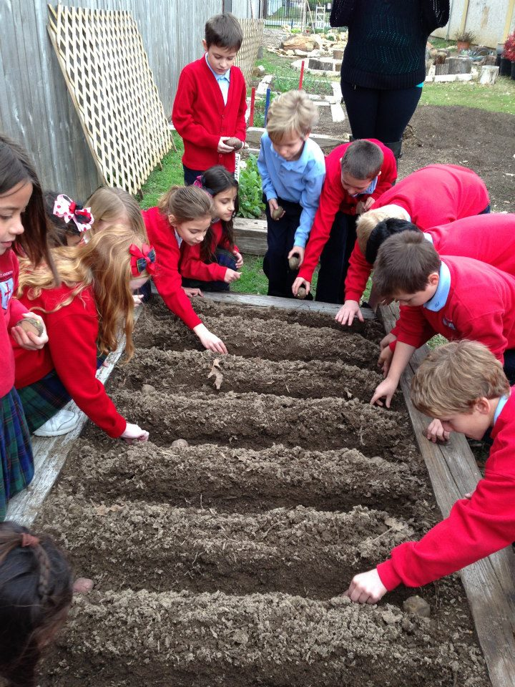
TROUBLE SHOOTING

Slide 28
TROUBLESHOOTING
Individuals receiving a plot assignment will be contacted by telephone or e-mail and may choose to accept the garden plot and complete the registration process within 30 days of notification. If registration for a new plot is not completed by this deadline, the vacant plot may be offered to the next person on the waiting list. Those individuals who are not successful in obtaining a garden plot assignment for the current year will maintain their numerical position, but must register again for the following year.
Gardeners are required to keep the (Your gardens’ name here) Garden Coordinator notified of changes to home address, phone number and e-mail addresses. Accurate contact information ensures delivery of renewal forms and other information in a timely manner. Your garden plot cannot be transferred to any person or persons.
Notes:
Policies /Procedures /Guidelines 2011
______________________________________________________________________________
The (Your gardens’ name here) is a public facility and one gardener’s actions may impact another’s use and enjoyment of the site. In order to effectively manage and protect the community resource and assure that everyone can enjoy the community gardening experience, the following procedures and guidelines have been established.
__________________________________________________________________
Registration Information
Returning Gardeners
The (Your gardens’ name here) will e-mail a reminder of plot renewal to all current gardeners the 1st of November. To renew your plot please send payment to: (Your gardens’ name and mailing address here)
Payment must be received by the last business day of December of the current year. If payment is not received by this deadline, the plot will be considered available for reassignment to another gardener.
New Gardeners
Beginning the 1st week of January, the (Your gardens’ name here) will provide information about plot availability for the coming season. New gardeners should look at different plot sites before registering if requesting a specific plot within the garden. Please note demand is high for garden plots, and the turnover rates are low.
Individuals receiving a plot assignment will be contacted by telephone or e-mail and may choose to accept the garden plot and complete the registration process within 30 days of notification. If registration for a new plot is not completed by this deadline, the vacant plot may be offered to the next person on the waiting list. Those individuals who are not successful in obtaining a garden plot assignment for the current year will maintain their numerical position, but must register again for the following year.
Gardeners are required to keep the (Your gardens’ name here) Garden Coordinator notified of changes to home address, phone number and e-mail addresses. Accurate contact information ensures delivery of renewal forms and other information in a timely manner. Your garden plot cannot be transferred to any person or persons.
Policies /Procedures /Guidelines 2011
______________________________________________________________________________
The (Your gardens’ name here) is a public facility and one gardener’s actions may impact another’s use and enjoyment of the site. In order to effectively manage and protect the community resource and assure that everyone can enjoy the community gardening experience, the following procedures and guidelines have been established.
__________________________________________________________________
Registration Information
Returning Gardeners
The (Your gardens’ name here) will e-mail a reminder of plot renewal to all current gardeners the 1st of November. To renew your plot please send payment to: (Your gardens’ name and mailing address here)
Payment must be received by the last business day of December of the current year. If payment is not received by this deadline, the plot will be considered available for reassignment to another gardener.
New Gardeners
Beginning the 1st week of January, the (Your gardens’ name here) will provide information about plot availability for the coming season. New gardeners should look at different plot sites before registering if requesting a specific plot within the garden. Please note demand is high for garden plots, and the turnover rates are low.
Individuals receiving a plot assignment will be contacted by telephone or e-mail and may choose to accept the garden plot and complete the registration process within 30 days of notification. If registration for a new plot is not completed by this deadline, the vacant plot may be offered to the next person on the waiting list. Those individuals who are not successful in obtaining a garden plot assignment for the current year will maintain their numerical position, but must register again for the following year.
Gardeners are required to keep the (Your gardens’ name here) Garden Coordinator notified of changes to home address, phone number and e-mail addresses. Accurate contact information ensures delivery of renewal forms and other information in a timely manner. Your garden plot cannot be transferred to any person or persons.

Slide 29
YOUR GARDEN LOGO AND ADDRESS HERE
ADOPT A PLOT RENTAL FORM (See Below)
>(Your gardens’ name here) will provide the garden plot and water. Mulch, compost and amendments will be provided when available.
>Gardeners will strive to be good stewards to the land, learn and use organic gardening methods to produce more disease resistant pest free plants and healthy, nutritious fruits and vegetables for consumption.
>The use of watering timers is not allowed, as mechanical failure could create a loss of water and ruin crops.
>Gardeners will be responsible for planting and keeping their allotted plot and adjacent paths weed free.
Notes:
YOUR GARDEN LOGO AND ADDRESS HERE
ADOPT A PLOT RENTAL FORM
PLEASE PRINT CLEARLY
Make Checks payable to: (Your gardens’ name here) and send to the above address
(Please circle one) New Gardener Renewing Gardener
Name:________________________________________________________________ Date:_______________
Mailing Address:___________________________________________________________________________
City, Zip Code:_____________________________________________________________________________
Phone Home:_______________________________________ Cell:___________________________________
Email:____________________________________________________________________________________
____I give permission to release to the media any photographs taken of myself or my family at the garden.
List others who will be working with you on your plot:______________________________________________
__________________________________________________________________________________________
Garden Plot Preference (please circle one): Standard Raised ADA Approved (limited)
____I would like to be partnered in a shared plot
Which of these areas motivate you to participate in the (Your gardens’ name here).
____Garden Education, ____Vegetable Production, ____Fruit Production, ____Social, ____Community Service,
____Growing Organic, ____Composting, ____Fundraising
*********************************************************************************************
For (Your gardens’ name here) Use Only:
Common Ground Garden Plot #_______________________________________
Start Date:_________________
Paid Processing Fee: Y N
Check #_________________
Cash $____________________ Other:___________________________________________________________
YOUR GARDEN LOGO AND ADDRESS HERE
Adopt a Plot Terms of Agreement for
(Your gardens’ name here)
>(Your gardens’ name here) will provide the garden plot and water. Mulch, compost and amendments will be provided when available.
>Gardeners will strive to be good stewards to the land, learn and use organic gardening methods to produce more disease resistant pest free plants and healthy, nutritious fruits and vegetables for consumption.
>The use of watering timers is not allowed, as mechanical failure could create a loss of water and ruin crops.
>Gardeners will be responsible for planting and keeping their allotted plot and adjacent paths weed free.
>Gardeners are encouraged to share a portion of their produce with others.
>Each gardener will support the garden by doing their fair share of common work. Four (4) scheduled workdays per year (every 3rd Saturday of each month) is required of each plot owner. Considerations will be given for special skills, physical and mental capabilities and age. Youth participation is encouraged with adult guidance.
>Gardeners agree to keep their plot mulched or in an approved cover crop when the plot is not in production. See Garden Policies/Procedures/Guidelines.
>Each gardener will be respectful of other gardeners, their crops and plot and will not harvest produce or flowers from another plot without the plot owner’s permission.
>Garden areas will be kept free of litter, tobacco, alcohol and drugs.
>Gardeners are urged to inform the Garden Steward if unable to maintain a plot (health issues or work) or if there is a grievance.
>Pets are not allowed within the garden, with the exception of service animals. Animal feces should not be composted.
>

Slide 30
HOLDING HARMLESS
“Hold Harmless” Example
* I THEREFORE AGREE TO HOLD HARMLESS THE (name of garden or city or church or landowner or all) FOR ANY LIABILITY, DAMAGE, and LOSS OR CLAIM THAT OCCURS IN CONNECTION WITH USE OF THE GARDEN BY ME OR ANY OF MY GUESTS. I AGREE TO FOLLOW ALL GUIDELINES SET FORTH.
Signature:________________________________________________________ Date:_________________
Notes:
Be Good Neighbor Guidelines
One of the key objectives in community gardening is to work together or next to each other in relative harmony. Please be courteous in all interactions and work together to resolve any disagreements. Please contact your Garden Coordinator or Garden Steward for guideline clarifications.
>Please lend a helping hand to others in need. (Your gardens’ name here) encourages gardeners to share a portion of your crop with those less fortunate. We will have scheduled pickups on Saturday mornings for any produce you would like to donate.
>Gardening in a public setting requires a fair amount of time and commitment. Please make appropriate arrangements to ensure a well-maintained garden space for everyone in this shared setting.
>Please respect the privacy of neighbors in and surrounding our community garden and be considerate when driving and parking in the area around the garden.
>Please be conscientious about water usage and do not leave water on overnight. Some garden areas do not have well-drained soil and neighboring plots or neighboring households can be easily affected by excess water. Limit watering to only intended crops and take steps to ensure that neighboring plots or neighboring households are not the recipients of excess water.
>Take care to ensure that the perimeter fencing at the garden site remains clear of vegetation from adjacent plots. In addition, soil, mulch, sod, or debris must not be piled or placed against the fence, as this promoted decay and shortens the life of the fence.

Slide 31
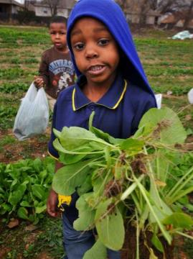
START YOUR GARDEN AND WATCH IT GROW

